Slide 1
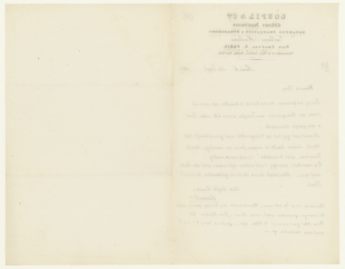
MOOD DETECTION IN HANDWRITING
THE LETTERS OF VINCENT VAN GOGH
LAUREN D. WHITMIRE
Notes:
Hi everyone, my name is Lauren Whitmire. For my final project I tried to detect mood in the handwriting of Vincent van Gogh.

Slide 2
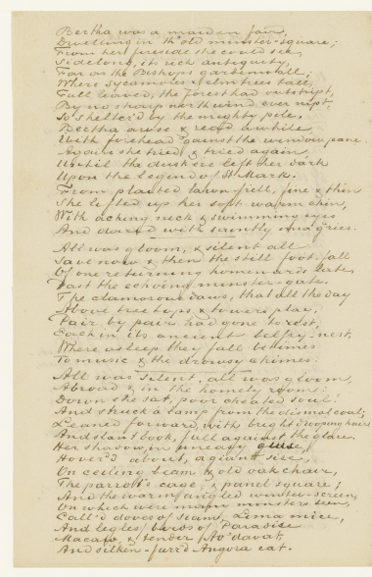

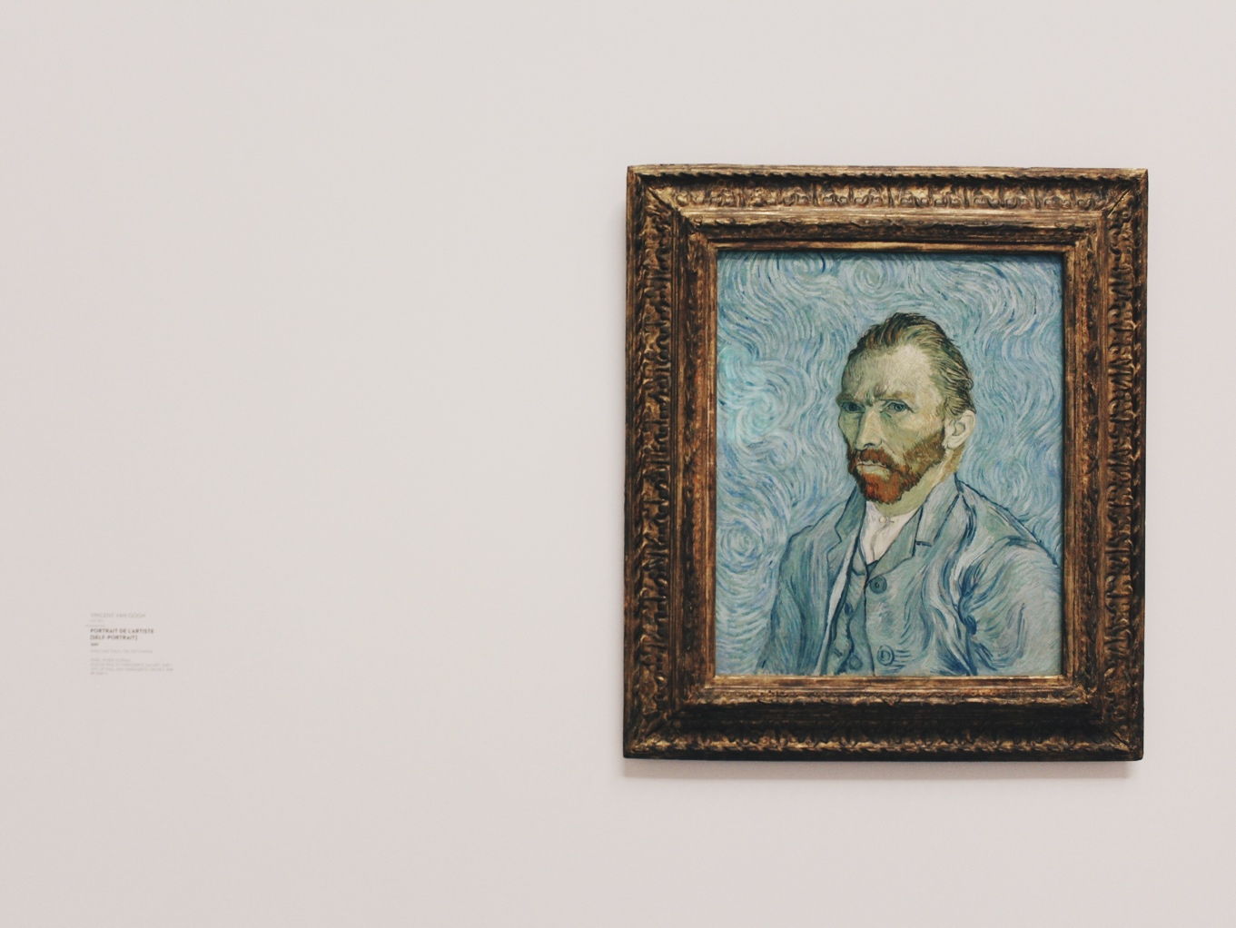
Notes:
There’s a field called graphology that tries to determine someone’s personality based on their handwriting. For example, if you write large letters, you might be extraverted.
This got me thinking, what happens if we analyze a collection of documents all authored by the same person? Can you monitor any changes in how they write over time, and is that indicative of any changes in their mood?
To do this, I used the surviving letters of Vincent van gogh

Slide 3
Notes:
There are over 800 letters, starting when Vincent was 19 years old, that are all pretty varied in content.
This letter is pretty upbeat. Vincent is telling his brother how he enjoys his walk to work and has recently taken up gardening.

Slide 4
Notes:
In contrast, this letter was written while they’re in the midst of an argument over Vincent has plans to propose to a prostitute. His brother doesn’t approve, so Vincent is asking him not to remove his financial support.

Slide 5
Notes:
If you look at these two letters side-by-side, you’ll notice the scratched out text and dramatic underlining is present in the second letter, but not in the first.
I decided to train a neural net to detect these differences, and then see if those differences have any relation to the mood of the letter itself.

Slide 6
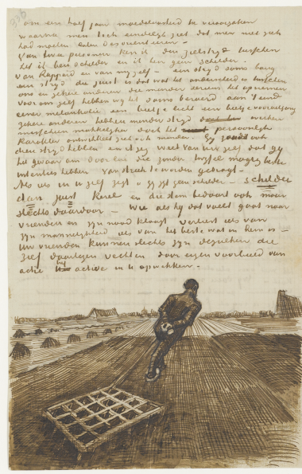
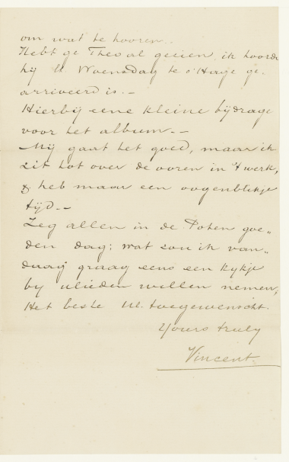
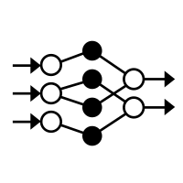




METHODOLOGY
My dear Theo,
I think your letter is really good, what you say about Rousseau and artists like Bodmer, that they are men in any case, and of such a kind that one would wish the world populated with people like that – yes indeed, that’s what I myself feel too.
Do you know that today, still, when I read by chance the story of some energetic industrialist or above all a publisher, that the same feelings of indignation then come to me again, the same feelings of anger from the old days when I was with G.&Cie.
NLP
Notes:
To do this, I took the scanned pages from van goghs letters and used a convolutional autoencoder to extract the physical features of each page, and then clustered the documents based on their physical similarities
I then took the text of each letter and used natural language processing to classify the sentiment of each. From there, I could see if there was any differences between the clusters.

Slide 7
IMAGE PREPROCESSING
Notes:
I performed a series of prepocessing steps using the PILLOW and scikit image libraries.
I converted each image to grayscale, resized to a uniform size, and then used adaptive thresholding to convert all images to a binary form and remove the background.

Slide 8
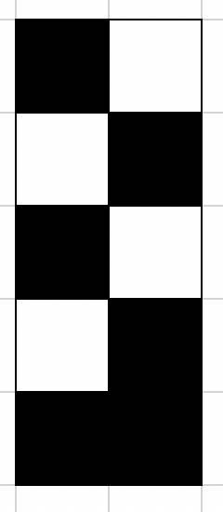
CONVOLUTIONAL AUTOENCODER
Encoder
Decoder
PCA
Notes:
To get a compressed representation of the images, I built a convolutional autoencoder that encodes each image into a reduced vector and then decodes that vector to recreate the original image.
I took this compressed vector and reduced it further with PCA
and clustered the result using kmeans, where I found 3 groups of documents

Slide 9
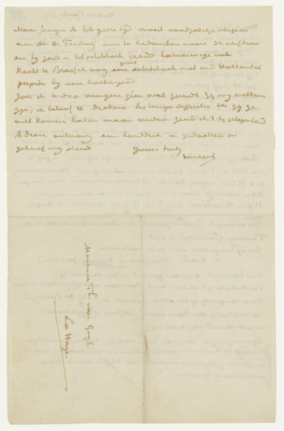
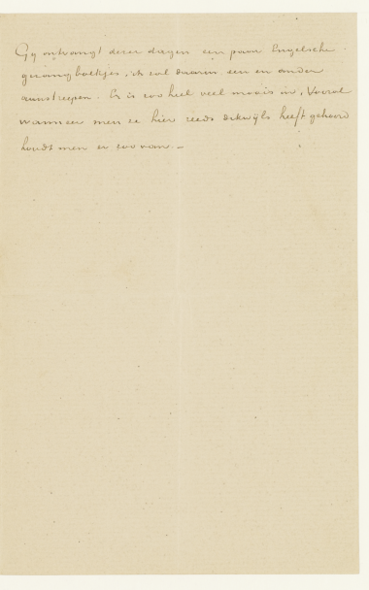
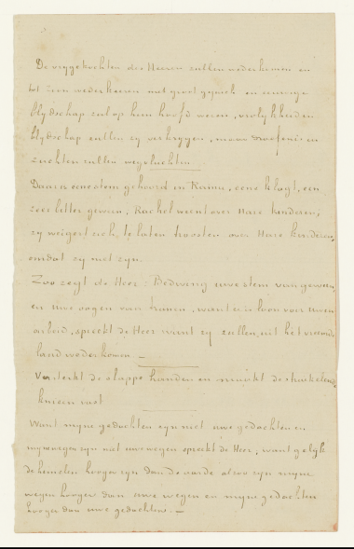
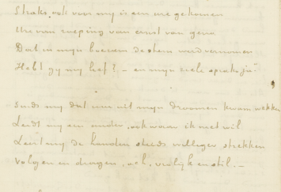
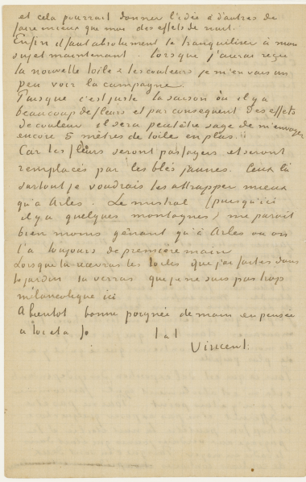
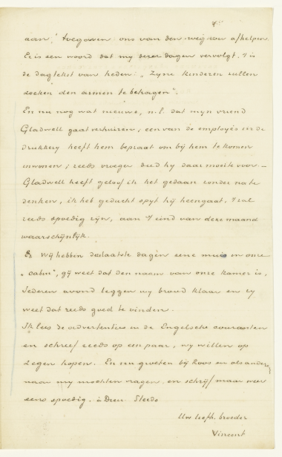
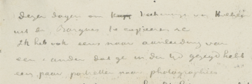
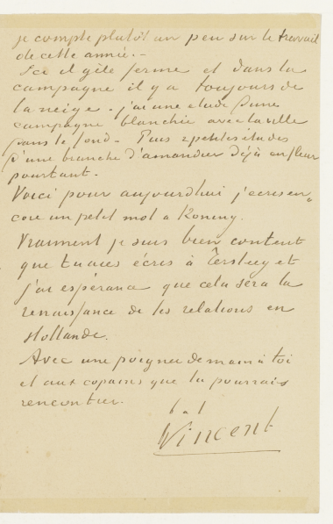
CLUSTER 1 – neat
Notes:
In the first cluster you can see that these pages are all fairly neat, and the handwriting is very uniform.
Cluster 1 (blue): neat
17/24 of his first letters are here

Slide 10
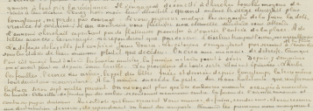
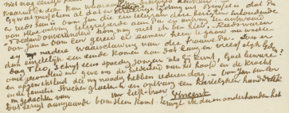
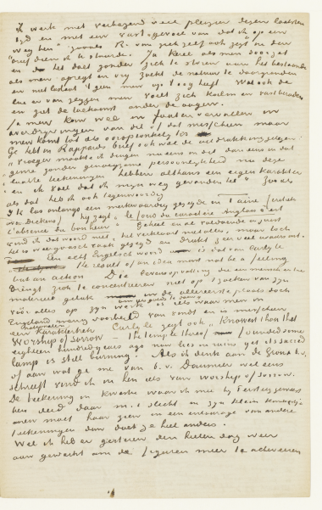
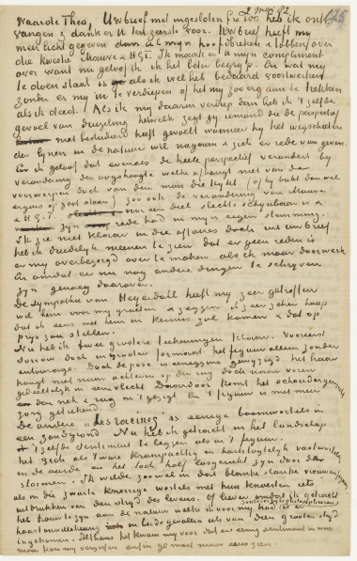
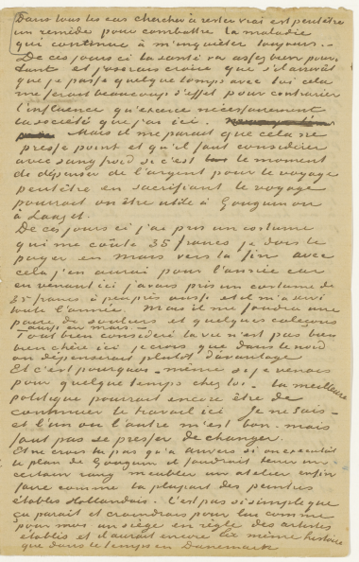
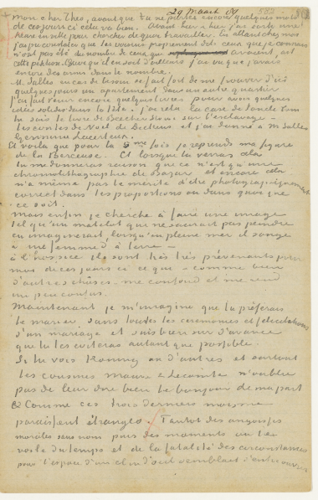
CLUSTER 2 – dense
Notes:
In the second cluster, the handwriting gets much more dense and cramped, and there were some regions of messy/scratched out text.
Cluster 3 (green): dense

Slide 11
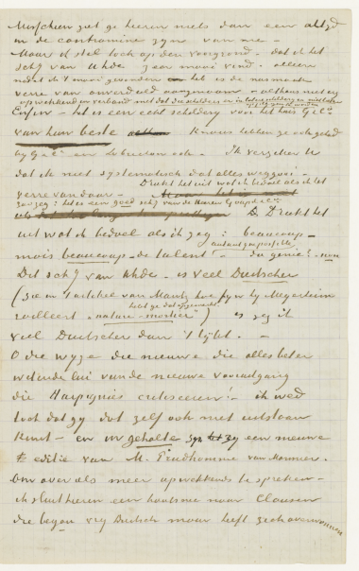
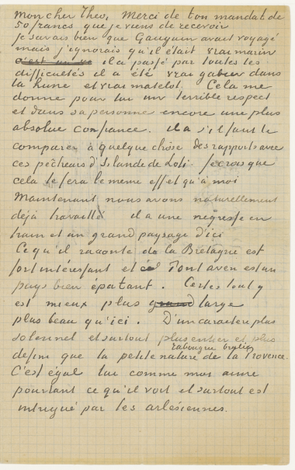
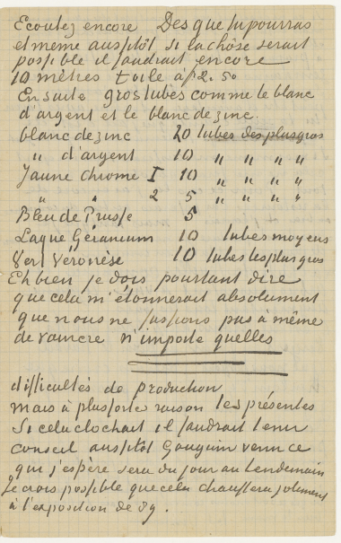
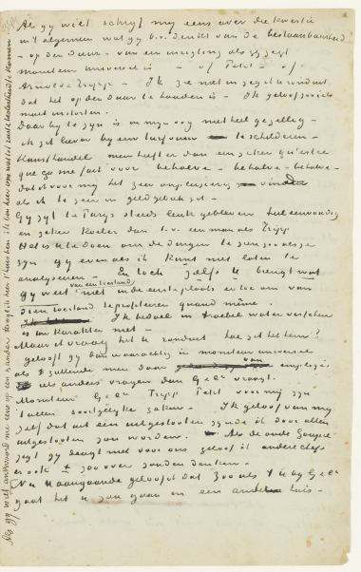
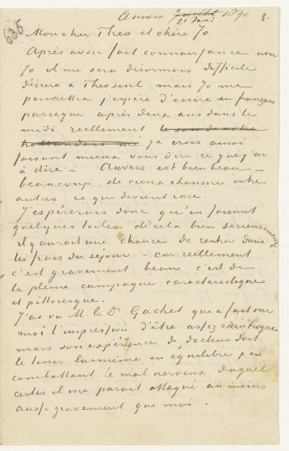
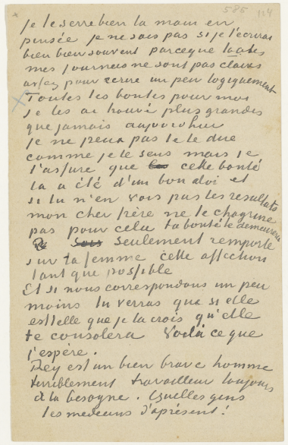
CLUSTER 3 – sloppy
Notes:
The final cluster contained pages that were much sloppier, with lots of scratched out text and underlining
Now that I had the letters clustered based on physical appearance,
Cluster 2 (orange): messy

Slide 12
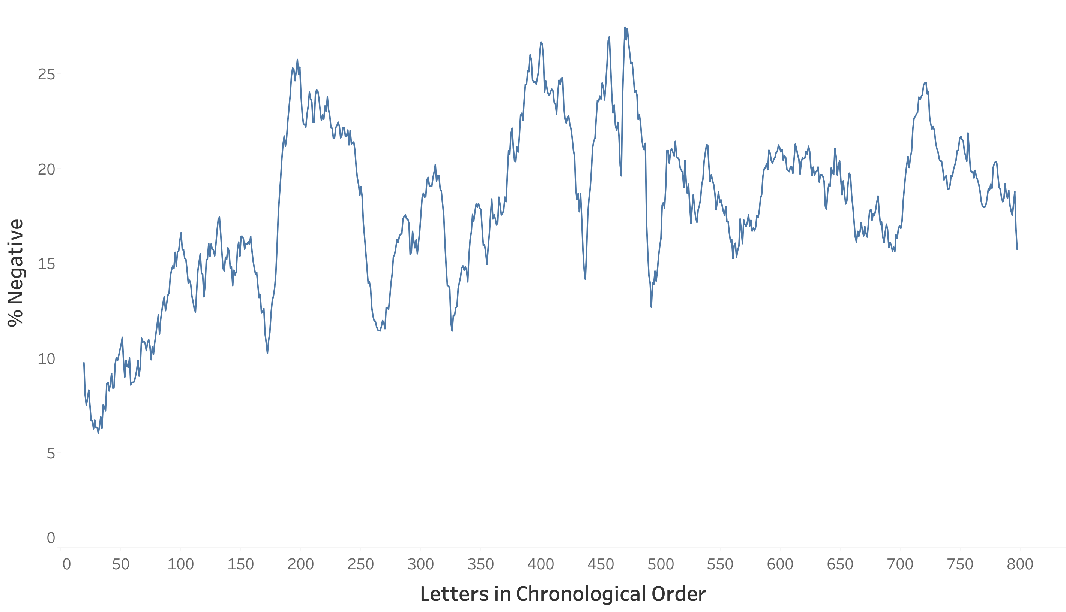
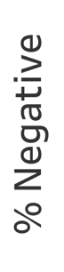
SENTIMENT ANALYSIS
kicked out of his parents’ house
girlfriend attempted suicide
suffered first mental breakdown
father died
Notes:
I used Vader sentiment analysis on the text of each letter
Here I’ve plotted the amount of negative sentiment in each letter, arranged in chronological order
The first thing you’ll notice is that his letters are increasingly negative over the course of his life, with his first 100 or so being the most positive.
You’ll also notice these regions where the amount of negative content spikes. I looked into these further and found that here is when he was kicked out of his parent’s house after a big fight, this middle region is when his girlfriend attempted suicide and his father died, and this final spike is when he had his first mental breakdown and infamously cut off part of his ear. This shows that the events going on in his life are reflected in the sentiment of his letters.

Slide 13




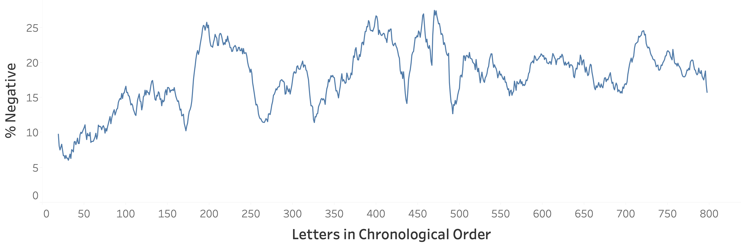

SENTIMENT ANALYSIS
1. Neat 2. Dense 3. Sloppy
Notes:
I then looked back to see how the letters in each of these regions were distributed across the clusters.
The darker the blue, the more letters are part of that cluster. So you can see that in his early letters, his letters are neat for the most part.
In this second region, the letters are almost all dense and cramped, and no letters fall under the neat cluster
Here, most of the pages are sloppy,
And in this final region, most of the letters fall under the dense category.
So, you can see, when van gogh is writing letters that are much more negative in tone, his letters become much more cramped and sloppy.
In other words, not only is there a mood difference in the letters, but the model is detecting a physical difference as well

Slide 14
CONCLUSIONS
Sentiment analysis provides a timeline of major events.
The use of neural nets and NLP shows some link between the mood of a letter and its physical appearance.
Notes:
In conclusion, sentiment analysis was able to provide a timeline of major events
The combined use of neural nets with NLP was able to show some link between the mood of a letter and its physical appearance, which is an approach that could be extended to analysis of other collections of handwritten documents

Slide 15

THANK YOU
LAUREN D. WHITMIRE
WHITMIRE.LAUREN@GMAIL.COM
LINKEDIN.COM/LAURENDWHITMIRE
GITHUB.COM/LAURENDWHITMIRE
Notes:
Again, my name is Lauren. Thank you for your attention and I look forward to speaking with you soon.

